Slide 1
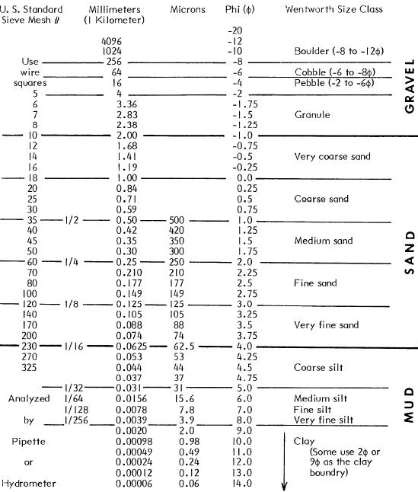

Slide 2
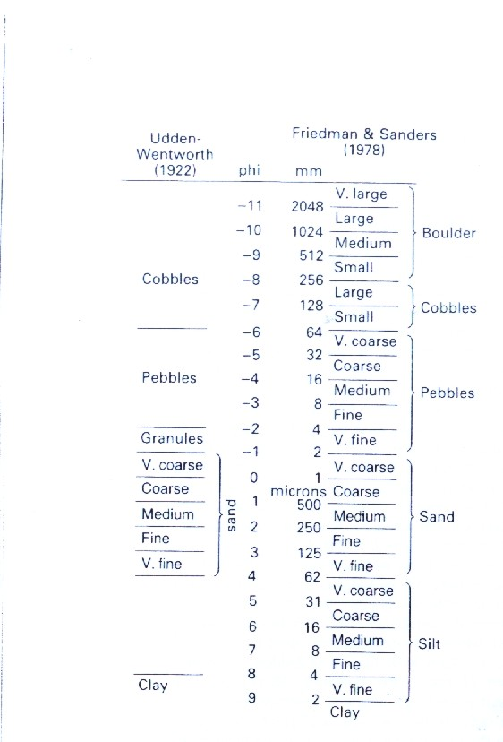

Slide 3
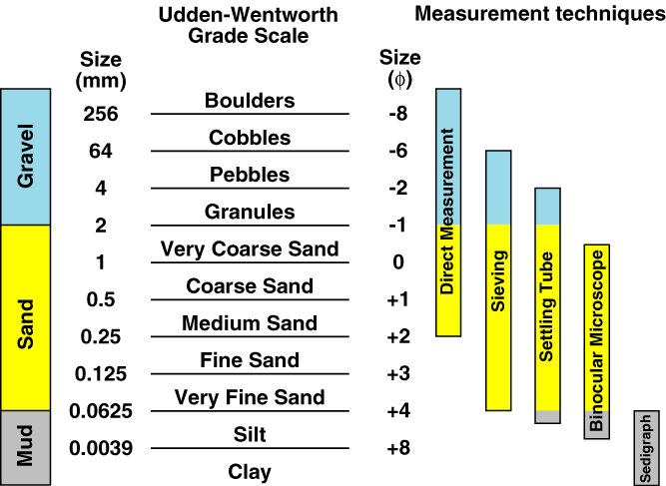
IV. Grade Scales
Grade scales define limits to a range of grain sizes for a given class (grade) of grain size.
Sedimentologists use the Udden-Wentworth Grade Scale.
Sets most boundaries to vary by a factor of 2.
They provide a basis for a terminology that describes grain size.
e.g., medium sand falls between 0.25 and 0.5 mm.

Slide 4
Sedmentologists often express grain size in units call Phi Units (φ; the lower case Greek letter phi).
Phi units assign whole numbers to the boundaries between size classes.
Phi was originally defined as:
To make Phi dimensionless it was
later defined as:
Where d_{O} = 1 mm.

Slide 5
Phi is the negative of the power to which 2 is raised such that it equals the dimension in millimetres.
2⁻⁰ = 1
2⁻² = 0.25
2⁻³ = 0.125
2⁻⁽⁻⁶⁾ = 64
With a calculator you can convert millimetres to Phi:
You can convert Phi to millimetres:

Slide 6
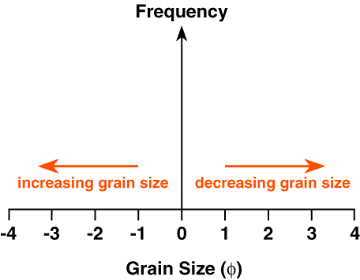
Note that when grain size is plotted as phi units grain size becomes smaller towards the right.

Slide 7
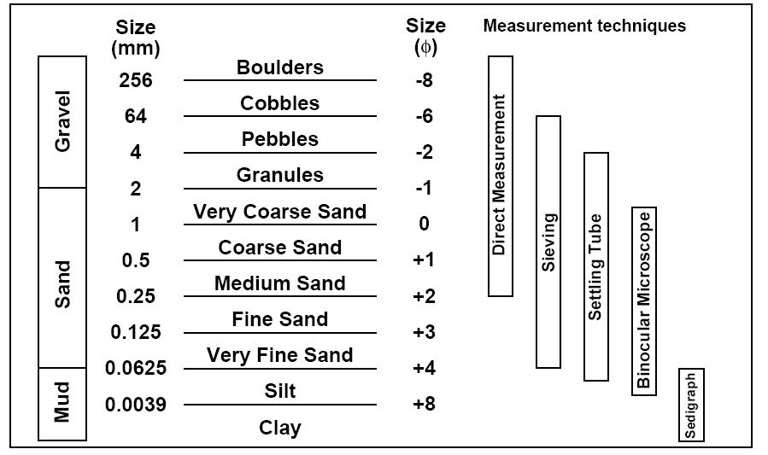

Slide 8
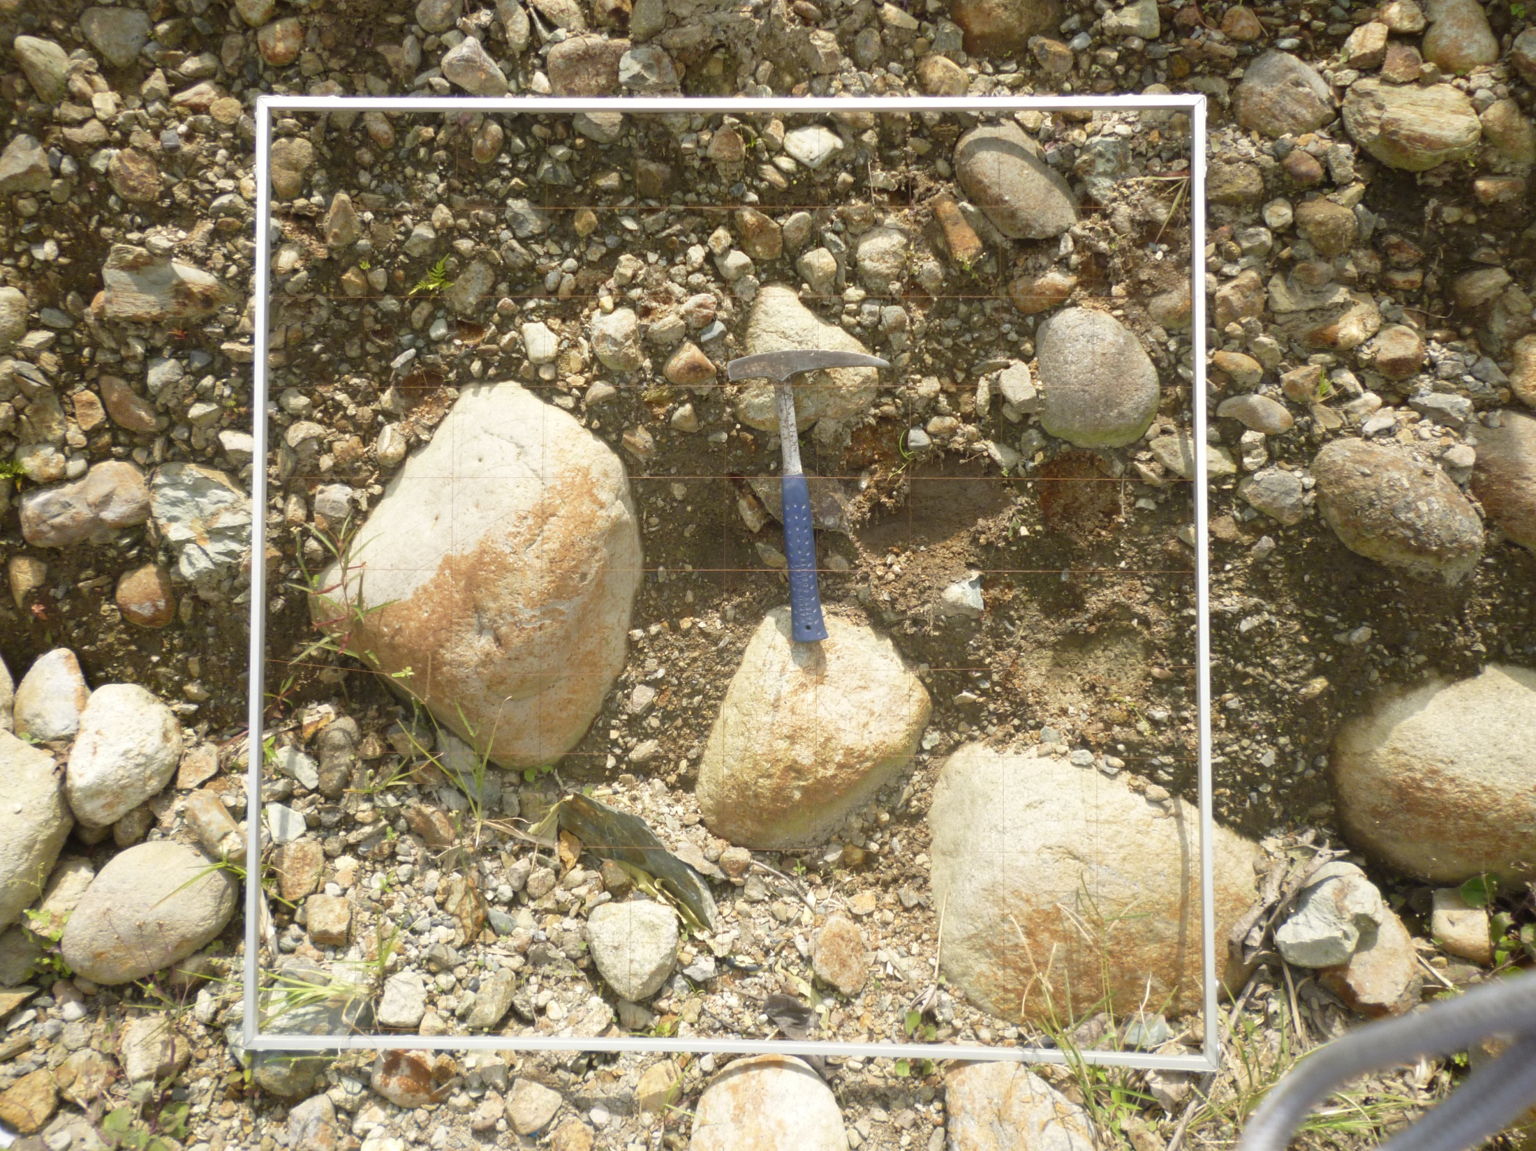

Slide 9
V. Describing Grain Size Distributions
a) Grain Size Data
Data on grain size distributions are normally collected by sieving.
1. Grain Size Class (φ) | 2. Weight (grams) | 3. Weight (%) | 4. Cumulative Weight (%)
-0.5 | 0.40 | 1.3 | 1.3
0 | 1.42 | 4.6 | 5.9
0.5 | 2.76 | 8.9 | 14.8
1.0 | 4.92 | 15.9 | 30.7
1.5 | 5.96 | 19.3 | 50.0
2.0 | 5.96 | 19.3 | 69.3
2.5 | 4.92 | 15.9 | 85.2
3.0 | 2.76 | 8.9 | 94.1
3.5 | 1.42 | 4.6 | 98.7
4.0 | 0.40 | 1.3 | 100
Total: | 30.92 | 100

Slide 10
1. Grain size class: the size of holes on which the weighed sediment was trapped in a stack of sieves.
2. Weight (grams): the weight, in grams, of sediment trapped on the sieve denoted by the grain size class.
3. Weight (%): the weight of sediment trapped expressed as a percentage of the weight of the total sample.
1. Grain Size Class (φ) | 2. Weight (grams) | 3. Weight (%) | 4. Cumulative Weight (%)
-0.5 | 0.40 | 1.3 | 1.3
0 | 1.42 | 4.6 | 5.9
0.5 | 2.76 | 8.9 | 14.8
1.0 | 4.92 | 15.9 | 30.7
1.5 | 5.96 | 19.3 | 50
2.0 | 5.96 | 19.3 | 69.3
2.5 | 4.92 | 15.9 | 85.2
3.0 | 2.76 | 8.9 | 94.1
3.5 | 1.42 | 4.6 | 98.7
4.0 | 0.40 | 1.3 | 100
Total: | 30.92 | 100
4. Cumulative Weight (%): the sum of the weights expressed as a percentage (column 3).

Slide 11
Each value in column 4 is the percentage of the sample that is coarser than the screen on which the sediment was trapped.
1. Grain Size Class (φ) | 2. Weight (grams) | 3. Weight (%) | 4. Cumulative Weight (%)
-0.5 | 0.40 | 1.3 | 1.3
0 | 1.42 | 4.6 | 5.9
0.5 | 2.76 | 8.9 | 14.8
1.0 | 4.92 | 15.9 | 30.7
1.5 | 5.96 | 19.3 | 50
2.0 | 5.96 | 19.3 | 69.3
2.5 | 4.92 | 15.9 | 85.2
3.0 | 2.76 | 8.9 | 94.1
3.5 | 1.42 | 4.6 | 98.7
4.0 | 0.40 | 1.3 | 100
Total: | 30.92 | 100

Slide 12
Each value in column 4 is the percentage of the sample that is coarser than the screen on which the sediment was trapped.
1. Grain Size Class (φ) | 2. Weight (grams) | 3. Weight (%) | 4. Cumulative Weight (%)
-0.5 | 0.40 | 1.3 | 1.3
0 | 1.42 | 4.6 | 5.9
0.5 | 2.76 | 8.9 | 14.8
1.0 | 4.92 | 15.9 | 30.7
1.5 | 5.96 | 19.3 | 50
2.0 | 5.96 | 19.3 | 69.3
2.5 | 4.92 | 15.9 | 85.2
3.0 | 2.76 | 8.9 | 94.1
3.5 | 1.42 | 4.6 | 98.7
4.0 | 0.40 | 1.3 | 100
Total: | 30.92 | 100
30.7% of the total sample is coarser than 1.0 φ.

Slide 13
Each value in column 4 is the percentage of the sample that is coarser than the screen on which the sediment was trapped.
1. Grain Size Class (φ) | 2. Weight (grams) | 3. Weight (%) | 4. Cumulative Weight (%)
-0.5 | 0.40 | 1.3 | 1.3
0 | 1.42 | 4.6 | 5.9
0.5 | 2.76 | 8.9 | 14.8
1.0 | 4.92 | 15.9 | 30.7
1.5 | 5.96 | 19.3 | 50
2.0 | 5.96 | 19.3 | 69.3
2.5 | 4.92 | 15.9 | 85.2
3.0 | 2.76 | 8.9 | 94.1
3.5 | 1.42 | 4.6 | 98.7
4.0 | 0.40 | 1.3 | 100
Total: | 30.92 | 100
30.7% of the total sample is coarser than 1.0 φ.
85.2% of the total sample is coarser than 2.5 φ.

Slide 14
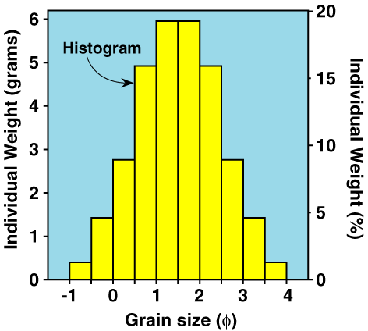
b) Displaying Grain Size Data
i) Histograms
Readily shows the relative amount of sediment in each size class.
Each bar width equals the class interval (0.5 φ intervals in this case).
Bars extend from the maximum size to the minimum size for each size class.

Slide 15
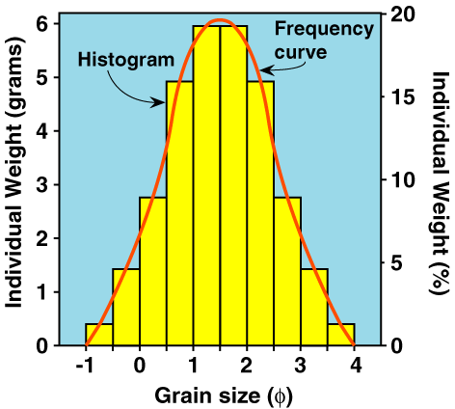
ii) Frequency Curves
A smooth curve that joins the midpoints of each bar on the histogram.

Slide 16
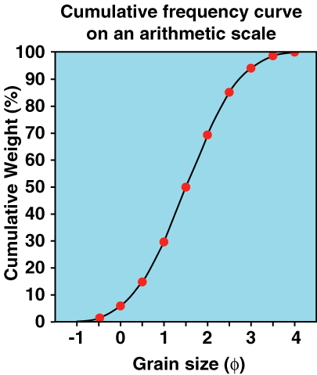
iii) Cumulative Frequency Curves
A smooth curve that represents the size distribution of the sample.
Several curves for different samples can be plotted together on one diagram for comparison of the samples.

Slide 17
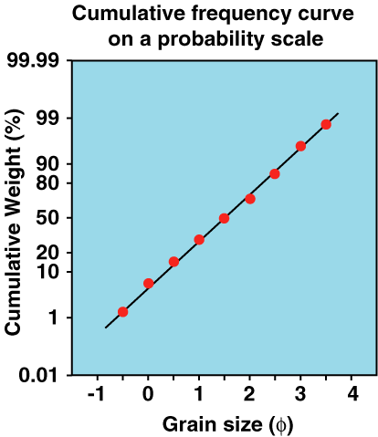
Sedimentologists commonly plot cumulative frequency curves on a probability scale for the cumulative frequency.
On such plots normal, bell shaped distributions plot as a straight line.

Slide 18
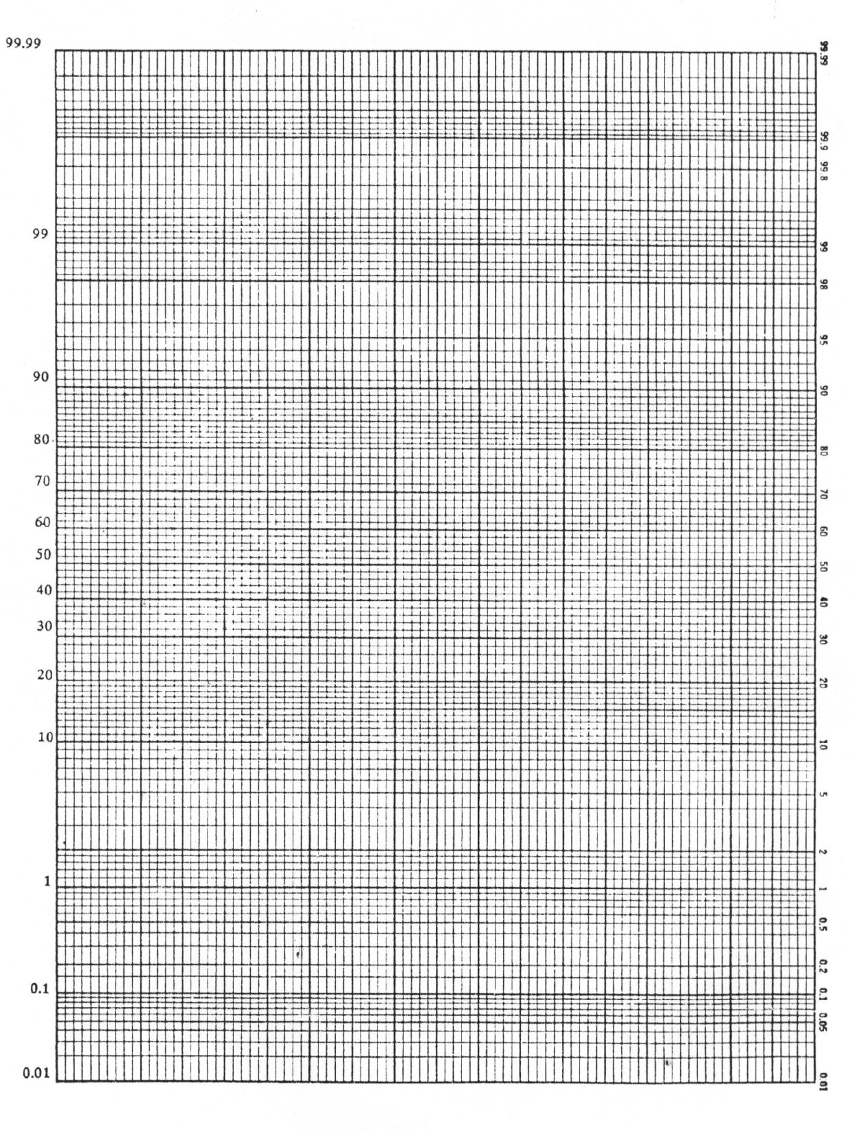

Slide 19
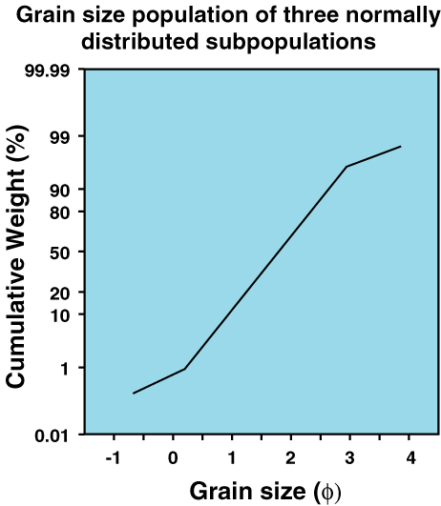
Plots of samples which are made up of normally distributed subpopulations plot as a series of straight line segments, each segment representing a normally distributed subpopulation.

Slide 20
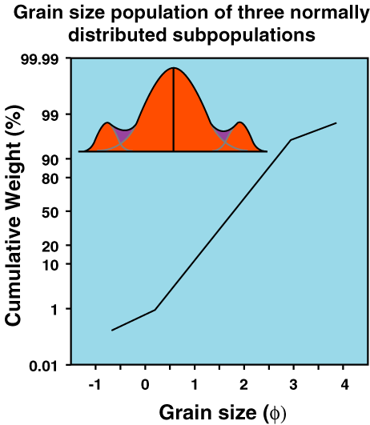
Plots of samples which are made up of normally distributed subpopulations plot as a series of straight line segments, each segment representing a normally distributed subpopulation.

Slide 21
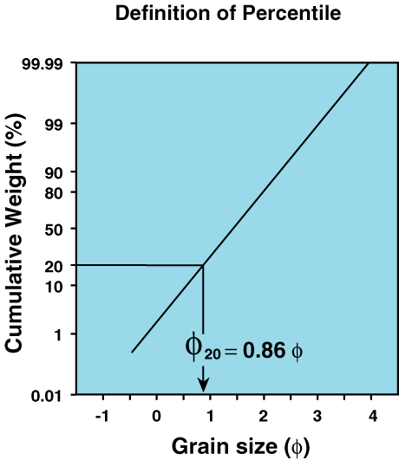
A benefit of cumulative frequency plots is that percentiles can be taken direction from the graph.
φ_{n} is the grain size that is finer than n% of the total sample.
φ_{n} is referred to as the nth percentile of the sample.
In the example φ₂₀ is 0.86φ
0.86φ is that grain size that is finer than 20% of the sample.
Conversely, 0.86φ is coarser than 80% of the sample.

Slide 22
c) Describing Grain Size Distributions.
Folk and Ward (1957) introduced the Graphic Method to estimate the various statistical parameters describing a grain size distribution using only percentiles taken from cumulative frequency curves.
Median
Mean
Standard deviation
Skewness
Kurtosis
)

Slide 23
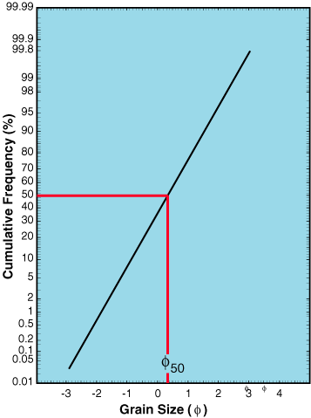
i) Median (Md)
The midpoint of the distribution; the 50th percentile.
50% of the sample is finer than the median and 50% of the sample is coarser than the median.
In this example the Median is approximately 0.35φ.

Slide 24
ii) Mean (M)
The arithmetic average of the distribution.
If the distribution is purely symmetrical M = Md.
The Udden-Wentworth Scale is used to define terms to describe the sediment based on the mean size.
Eg., if M = 0.34φ, the sample is said to be coarse sand.

Slide 25
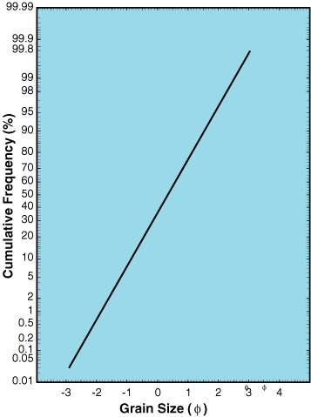
Example calculation of the Mean:
Mean
1. Determine φ₁₆, φ_{50and} φ₈₄

Slide 26
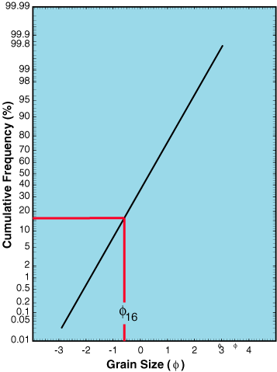
Example calculation of the Mean:
Mean
1. Determine φ₁₆, φ_{50and} φ₈₄
φ₁₆ = -0.59φ

Slide 27
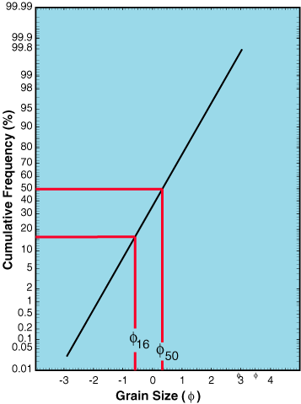
Example calculation of the Mean:
Mean
1. Determine φ₁₆, φ_{50and} φ₈₄
φ₁₆ = -0.59φ
φ₅₀ = 0.35φ

Slide 28
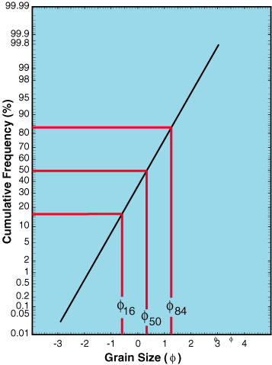
Example calculation of the Mean:
Mean
1. Determine φ₁₆, φ_{50and} φ₈₄
φ₁₆ = -0.59φ
φ₅₀ = 0.35φ
φ₈₄ = 1.27φ

Slide 29
Example calculation of the Mean:
Mean
1. Determine φ₁₆, φ_{50and} φ₈₄
φ₁₆ = -0.59φ
φ₅₀ = 0.35φ
φ₈₄ = 1.27φ
= 0.34φ

Slide 30
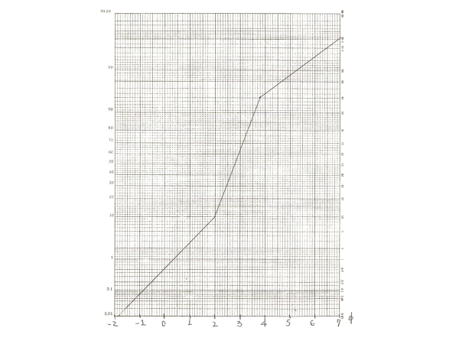
95

Slide 31
95

Slide 32
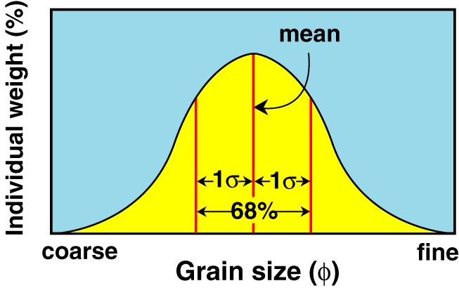
iii) Standard Deviation (σ; lower case Greek letter sigma)
Also referred to as the sorting coefficient or dispersion coefficient of a sediment.
The units of sorting are phi units.
A measure of how much variation in grain size is present within a sample.
68% of the total weight of sediment in a sample falls within +/- 1 standard deviation of the mean.
E.g., M = 0.34φ and σ = 0.75φ
68% of the sample falls in the range from -0.41 to 1.09φ.

Slide 33
c) Describing Grain Size Distributions.
Folk and Ward (1957) introduced the Graphic Method to estimate the various statistical parameters describing a grain size distribution using only percentiles taken from cumulative frequency curves.
Median
Mean
Standard deviation
Skewness
Kurtosis
)

Slide 34
Sedimentologists use a specific terminology to describe the sorting of a sediment:
Very well sorted 0 < σ < 0.35φ
Well sorted 0.35 < σ < 0.50φ
Moderately well sorted 0.5 < σ < 0.71φ
Moderately sorted 0.71 < σ < 1.00φ
Poorly sorted 1.00 < σ < 2.00φ
Very poorly sorted 2.00 < σ < 4.00φ
Extremely poorly sorted σ > 4.00φ

Slide 35
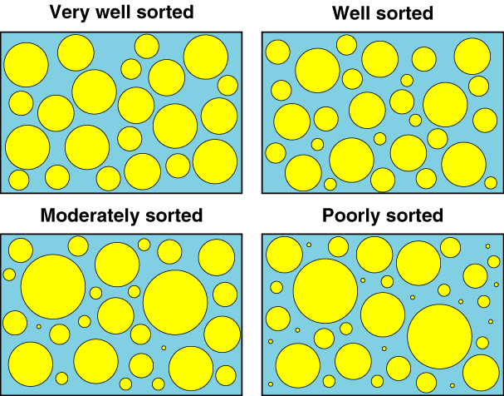
Examples of sorting:

Slide 36
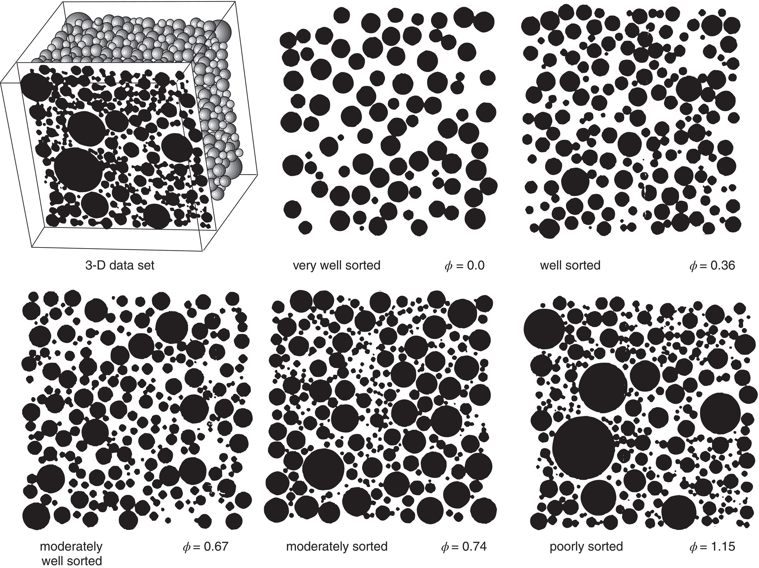
Visual comparators for sorting for thin‐sections based on 3‐D distributions

Slide 37
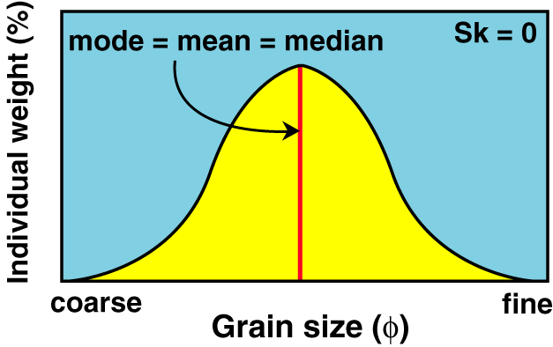
iv) Skewness (Sk)
A measure of the symmetry of the distribution.
Values range from –1.0 to +1.0.
Sk = 0
Perfectly symmetrical.
Md = M

Slide 38
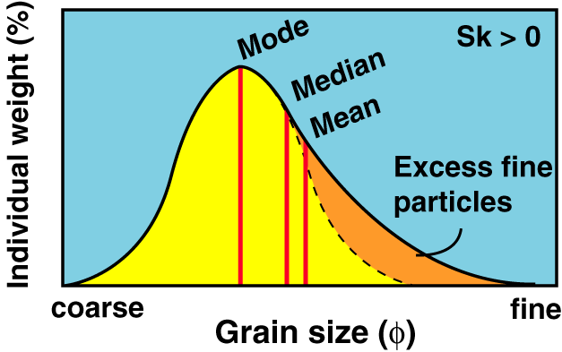
Sk > 0
The distribution has more fine particles than a symmetrical distribution would have.
The distribution is said to be fine tailed.
M is finer than Md

Slide 39
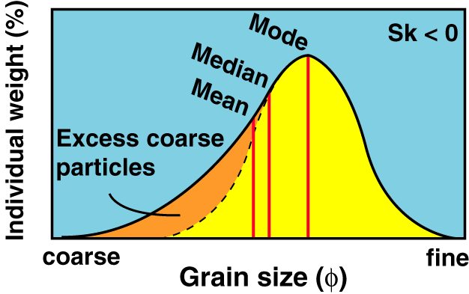
Sk < 0
The distribution has more coarse particles than a symmetrical distribution would have.
The distribution is said to be coarse tailed.
M is coarser than Md

Slide 40
c) Describing Grain Size Distributions.
Folk and Ward (1957) introduced the Graphic Method to estimate the various statistical parameters describing a grain size distribution using only percentiles taken from cumulative frequency curves.
Median
Mean
Standard deviation
Skewness
Kurtosis
)

Slide 41
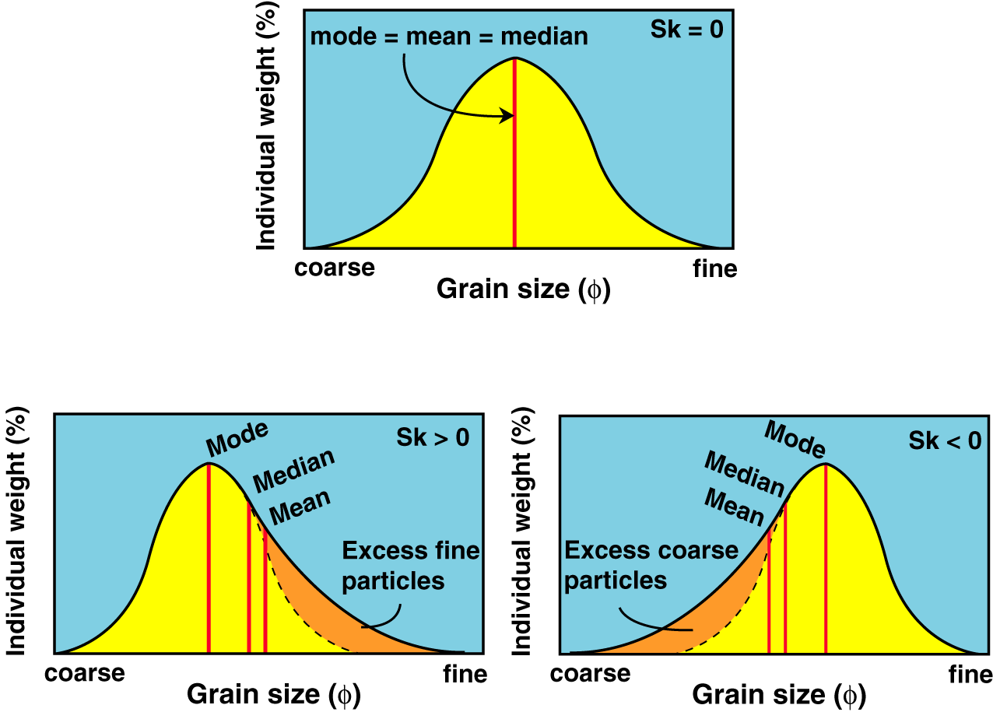
Terminology:
Sk > 0.3 strongly fine skewed
0.1 < Sk < 0.3 fine skewed
-0.1 < Sk < 0.1 near symmetrical
-0.3 < Sk < -0.1 coarse skewed
Sk < -0.3 strongly coarse skewed

Slide 42
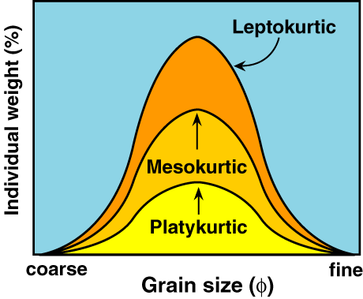
v) Kurtosis (K)
A measure of the peakedness of the distribution (related to sorting).
K > 1 sharp peaked (Leptokurtic)
K = 1 normal (Mesokurtic)
K < 1 flat peaked (Platykurtic)

Slide 43
c) Describing Grain Size Distributions.
Folk and Ward (1957) introduced the Graphic Method to estimate the various statistical parameters describing a grain size distribution using only percentiles taken from cumulative frequency curves.
Median
Mean
Standard deviation
Skewness
Kurtosis
)

Slide 44
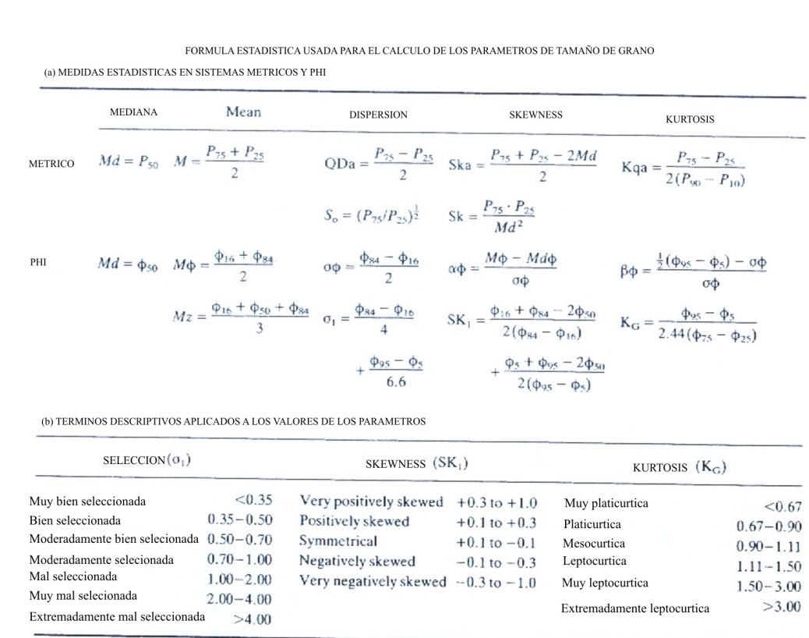

Slide 45
VI. Implications of Grain Size
Grain size is a fundamental property of any granular material.
It influences other fundamental properties.
Historically it was hoped that ancient depositional environments could be determined on the basis of grain size and grain size distributions.
When drilling wells (oil, gas, water) the most abundant samples are small pieces of rock called “drill chips”.

Slide 46
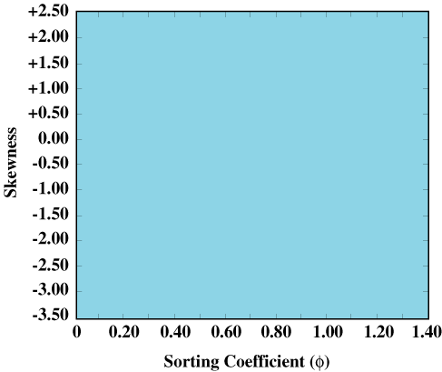
One attempt to distinguish depositional environments on the basis of grain size distribution focused on beach versus river sands.
Samples were collected from rivers and beaches (both lake and ocean beaches) and Skewness was plotted against Sorting Coefficient.

Slide 47
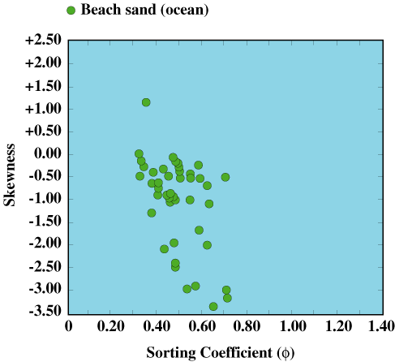

Slide 48
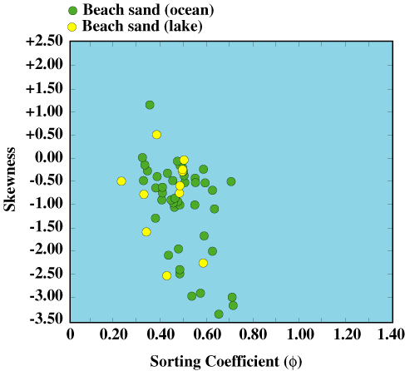

Slide 49
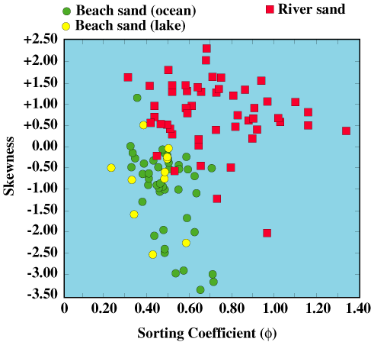

Slide 50
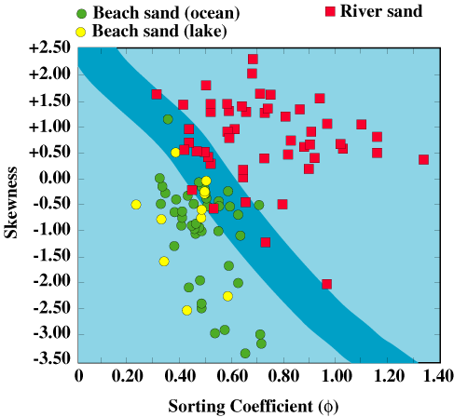

Slide 51
Beaches tend to have sands that are better sorted and with more common coarse tail skewness than river sands.
This reflects the difference in processes that act in rivers and beaches.
Rivers transport a wide range of grain sizes: large particles move in contact with the bed and large volumes of fine particles are carried in suspension in the current.
Their deposits tend to be relatively poorly sorted and rich in fine particles (+ve or fine tailed skewness).

Slide 52
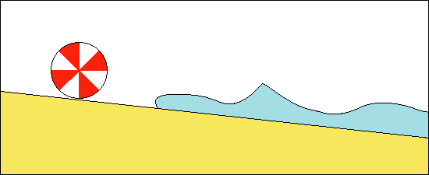
Beaches experience repeated swash and backwash of waves running up the beach face.
The repeated action of the currents washes fine sand from the beach (improving its sorting) and leaving larger grains behind (causing coarse tail skewness).

Slide 53
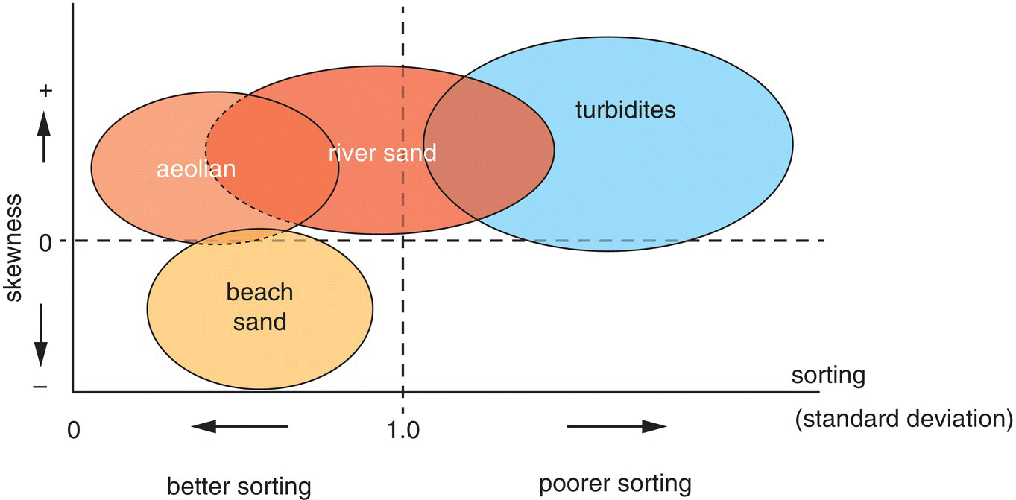
Skewness and sorting grain‐size distribution parameters which are suitable for distinguishing between sediments deposited in different environments

Slide 54
The difference in processes acting on beaches and in rivers results in distinct differences in their grain size distributions.
Other attempts to apply this method had limited results.
The problem is that grain size distribution can be inherited from the source material that makes up the sediment.
If a beach forms on ancient river sediments then the beach deposits will inherit characteristics of river deposits.
If a river erodes through ancient beach deposits then its sediment will bear the characteristics of beach sediments.

Slide 55
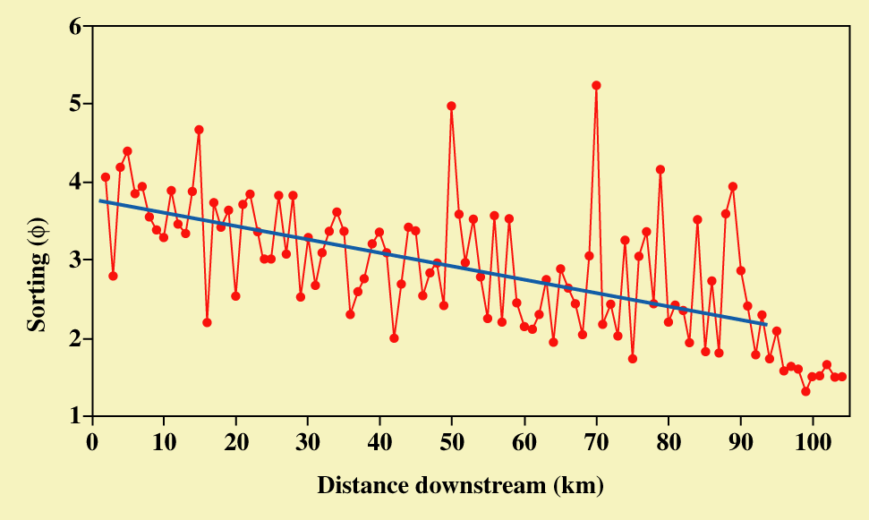
In rivers it has been found that, overall, sorting of a sediment improves with the distance of transport.
The longer the distance of transport the greater the opportunity to remove fine material (in suspension) and to leave coarser material behind, reducing the range of grain sizes present (improving the sorting and decreasing the sorting coefficient).
From: Gomez, Rosser, Peacock, Hicks and Palmer, 2001, Downstream fining in a rapidly aggrading gravel bed river. Water Resources Research, v. 37, p. 1813-1823.

Slide 56
Why measure Grain Size?
1. It is a fundamental property of any granular material.
2. It influences a variety of other properties.
3. It gives clues to the history of a sediment (more details later in the course).

Slide 57
Grain Shape
An individual property (rather than a bulk property) that is as fundamental as grain size.
Shape can be described in a variety of ways:
Roundness: a description of how angular the edges of a particle are.
Sphericity: how closely a particle’s shape resembles a sphere.
Form: the overall appearance of a particle.
Surface texture: scratches, pits, grooves, etc. on a particle’s surface.

Slide 58
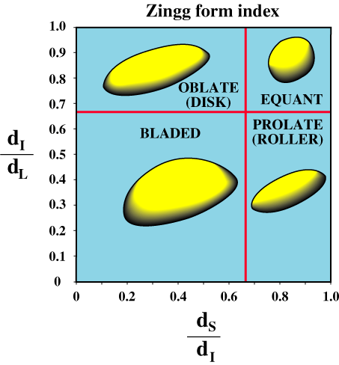
III. Form
Provides a consistent terminology for describing the overall form of particles.
Based on various ratios of d_{L}, d_{I} and d_{S}
a) Zingg Form Index
Assigns specific shape terms based on ratios of d_{I}/d_{L} and d_{S}/d_{I}.
Independent of sphericity although equant particles are highly spherical.

Slide 59
II. Sphericity
A measure of how closely a particle resembles a sphere.
Usually denoted by Ψ, the capital Greek letter psi.
A measure of sphericity is useful to determine whether or not Stoke’s Law of settling is applicable (e.g., how much a particle differs from a sphere).
Sphericity determines the use of a sediment (e.g., high sphericity sediment is not particularly good for making concrete).

Slide 60
b) Sneed and Folk (Ψ_{P}) or Maximum Projection Sphericity
Ψ_{P}: the ratio of the maximum projection area of a sphere with volume equal to the particle to the maximum projection area of the particle.
Sneed and Folk argued that it was the projection area of a particle that experienced the viscous drag of moving fluid, therefore it was more important than the volume of the particle.
With increasing sphericity.

Slide 61
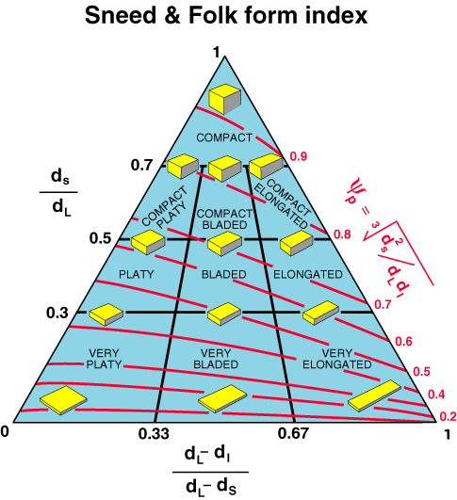
b) Sneed and Folk Form Index
Defines 10 shape classes.
Shows sphericity for each class.

Slide 62
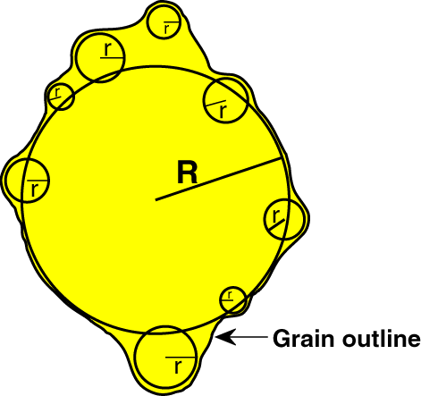
I. Roundness
Several methods of description; some more practical than others.
a) Wadell’s Roundness (R_{W})
Time consuming and very impractical but results are reliable.
R_{W}: the ratio of the average radius of curvature of the corners on the surface of a grain to the radius of curvature of the largest circle that can be inscribed within the projection of the particle.
Where N is the number of corners.
R_{W} approaches 1 for a perfectly round particle.

Slide 63
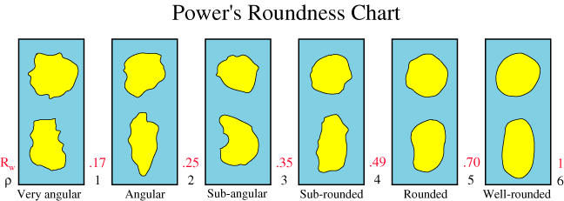
b) Dobson and Fork Roundness (R_{F})
R_{F}: the ratio of the radius of curvature of a particle’s sharpest corner (r) to the radius of curvature of the largest circle that can be inscribed on the projection of the particle (R).
c) Power’s visual comparison chart.

Slide 64
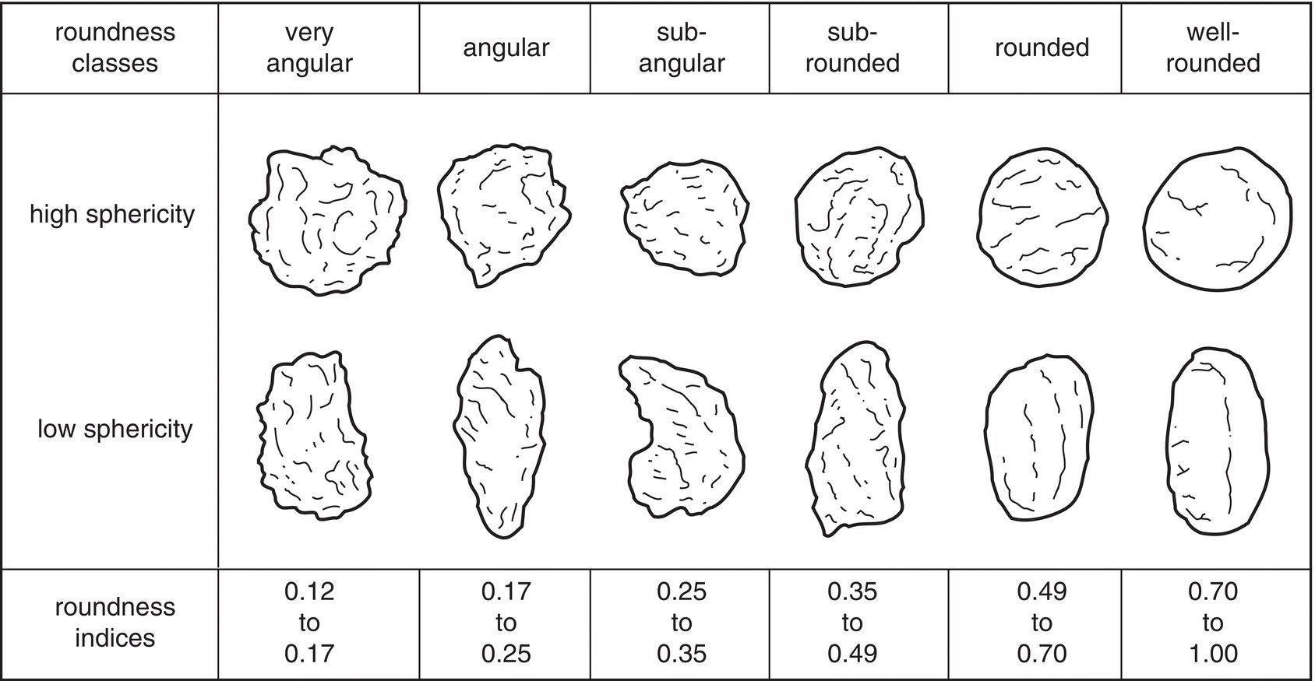
Chart for estimating the roundness and sphericity of sedimentary particles

Slide 65
The most commonly used method of determining roundness.
Defines terms for describing roundness.
e.g., 0.25 < R_{W} <0.35 is termed sub-angular.
Also gives a “shape parameter” (ρ) which is a logarithmic transformation of R_{W} so that the boundaries between roundness classes are whole numbers.

Slide 66
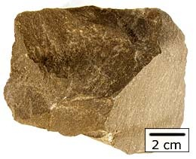
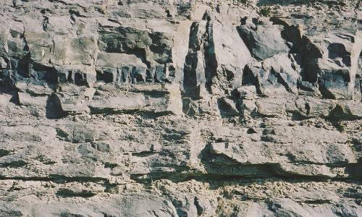
IV. Implications of particle shape
a) Controls on particle shape.
i) Lithology
For particles that are rock fragments aspects of the lithology of the source rock can influence shape.
Massive source rocks (non-bedded) tend to produce more equant particles (e.g., granite, massive sandstone, etc.).
Bedded and foliated rocks tend to produce more platy particles (e.g., well-bedded limestones).

Slide 67
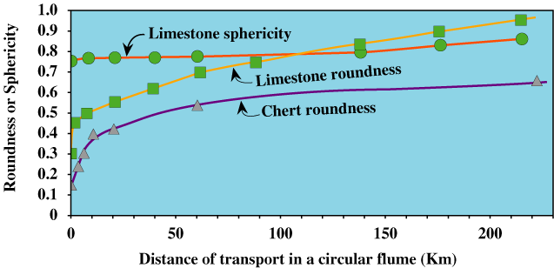
The following figure reports data derived from long distance transport of blocks cut initially as cubes within a circular flume.
Changes in roundness and sphericity for cubes of chert (a very hard rock type) and softer limestone.
Roundness increases for limestone much more quickly with transport than the harder chert, especially during the early phase of transport.

Slide 68
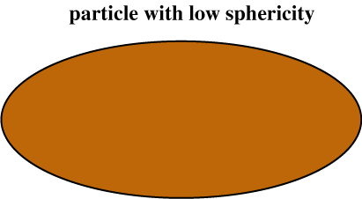
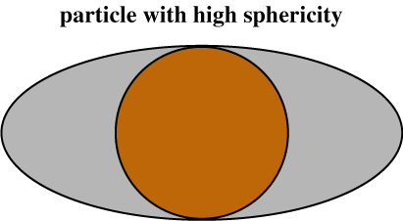
Sphericity changes shape only very slowly because the particles began as relatively equant shaped cubes (i.e., with high sphericity to begin with).
Relatively large masses of material must be removed to significantly change the sphericity of a particle.
Gray area must be
removed to increase
sphericity.

Slide 69
ii) Hardness
Particularly hard clasts (e.g., granite, quartz-cemented sandstone, etc.) change in shape during transport less readily than softer lithologies.
Softer lithologies (e.g., limestone) change shape much more readily.
Unconsolidated material (e.g., cohesive mud) changes shape almost immediately when it is transported.
b) Changes in Shape by Transport
Transport of particles by water, wind or flowing glaciers has the potential to cause changes to their shape over time.
During transport particles interact with each other and with the surface over which they move.
Shape is modified by grinding, chipping and crushing that takes place due to this interaction.

Slide 70
The following figure reports data derived from long distance transport of blocks cut initially as cubes within a circular flume.
Changes in roundness and sphericity for cubes of chert (a very hard rock type) and softer limestone.
Roundness increases for limestone much more quickly with transport than the harder chert, especially during the early phase of transport.

Slide 71
The rate of increase in roundness is greatest during early transport for both rock types.
As rounding takes place it becomes increasingly more difficult to change the shape to further improve roundness.

Slide 72
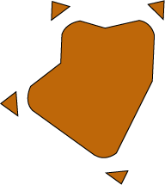
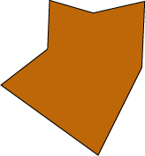
With an initially angular particle it is relatively easy to increase roundness by breaking off the sharp corners.

Slide 73
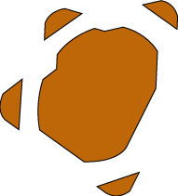
As the particle becomes rounder, larger and larger masses of material must be removed to cause a comparable increase in roundness.

Slide 74
Gravel size material changes shape relatively rapidly with transport in comparison to sand size material.
Shape change in sand can be inferred from rates of change of weight of particles with transport; changes in shape require changes in mass.
For quartz grains in the size range 2 mm to 0.05 mm, that are transported in water, the weight loss is <0.1% per 1000 km of transport (the rate is doubled for feldspars).
For quartz grains finer than 0.05 mm that are transported in water there is virtually no change in weight with transport.

Slide 75
Why so little change in very fine sand?
Breakage takes place during collisions (between grains and a solid substrate) and depends on the amount of momentum that is exchanged during collisions.
Momentum = mass × velocity
Very fine sand, silt and clay particles have very small mass so that they have little momentum.
During collisions there is little momentum exchanged and, therefore, little breakage which is required to change the mass and shape of the grains.
Momentum is further reduced when transport is in water because the buoyant force reduces its effective weight.
Most of the particle’s momentum is used in “pushing” the water as the particle moves, losing momentum due to the viscosity of the water.

Slide 76
When transport is in water there is little momentum to cause breakage and change in shape.
Finally, we’ll see later that particles finer than 0.05 mm are transported in suspension (floating in the water column), further reducing the chances of shape-changing collisions.
Transport by wind is more effective in changing the shape of fine grains.
Air has low density (little buoyant force) and very low viscosity so that there is more momentum exchanged during collisions.
Rate of weight loss is 100 to 1000 times that when transport is in water.
Eolian desert sands tend to have relatively high sphericity.

Slide 79
(a) Stages of textural maturity of sands depicted as a function of input of kinetic energy. (b) Relationship of maturity and depositional environment.

