Slide 1
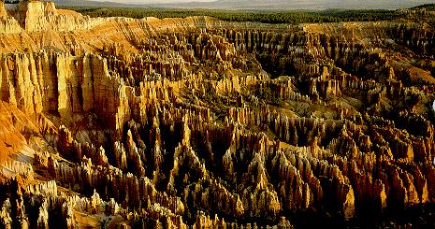
Weathering
Weathering is simply the chemical and/or physical breakdown of a rock material--weathering involves specific processes acting on rock materials at or near the surface of the Earth

Slide 4
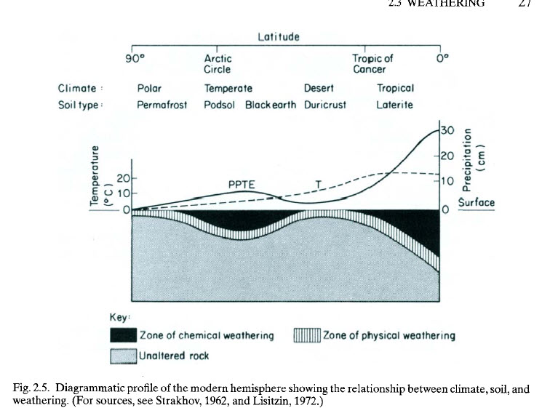

Slide 5
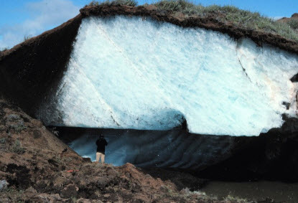

Slide 12
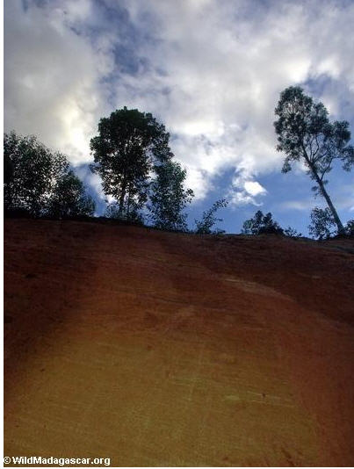

Slide 13
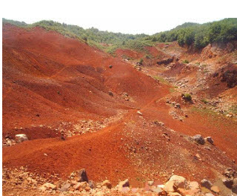

Slide 15
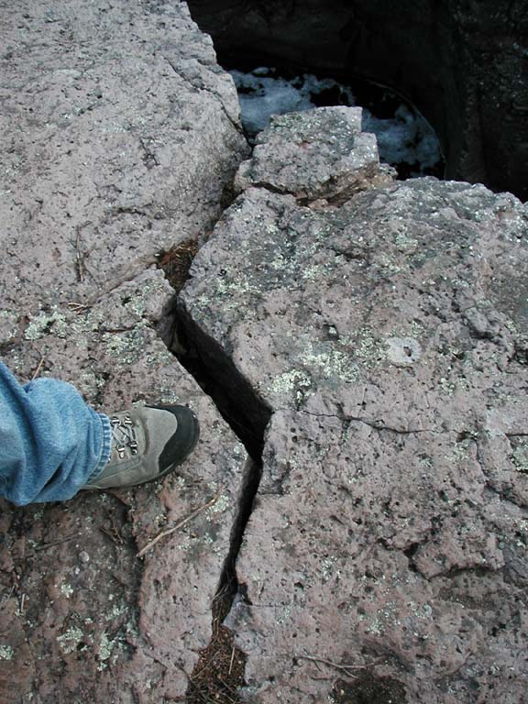
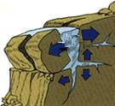
Frost Wedging

Slide 18
Chemical Weathering
The process that breaks down rock through chemical changes.
The agents of chemical weathering
Water
Oxygen
Carbon dioxide
Living organisms
Acid rain

Slide 19
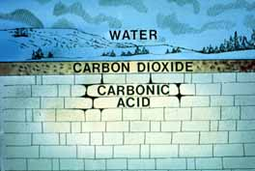
Carbon Dioxide
CO₂ dissolves in rain water and creates carbonic acid
Carbonic acid easily weathers limestone and marble

Slide 20
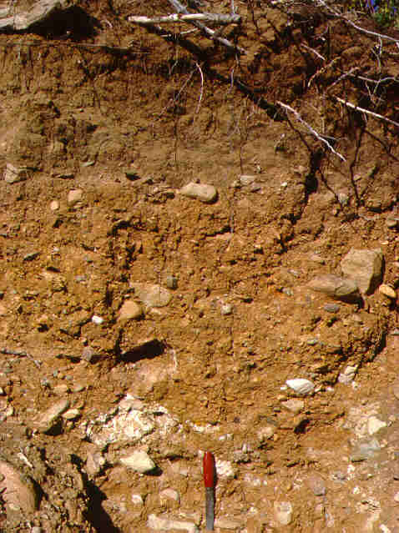
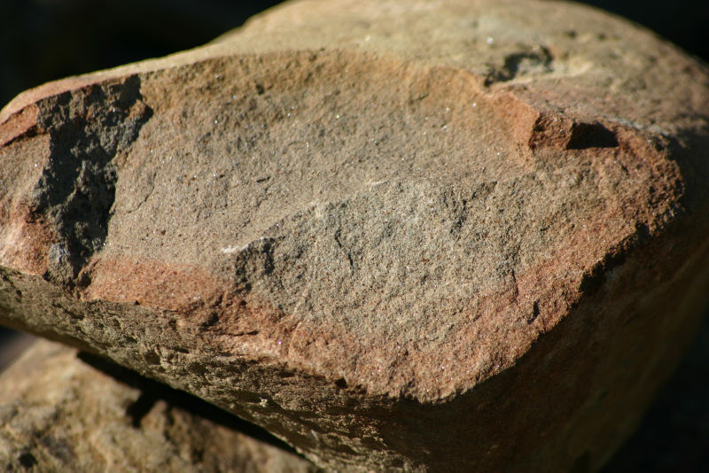
Oxygen
Iron combines with oxygen in the presence of water in a processes called oxidation
The product of oxidation is rust

Slide 21
Weathering > Chemical
Chemical Weathering is corrosion of rocks.
The near surface environment differs from deeper environments in the abundance of water and oxygen and the presence of CO₂, which forms a weak acid when mixed with water. Most chemical weathering is due to oxidation, dissolution, or hydrolysis.
Oxidation – Redox, Electron exchange Often is the addition of oxygen
4Fe⁺² + O₂ → 4Fe⁺³+2O⁻² (Iron is oxidized, Oxygen is reduced)
4FeSiO₃ + O₂ → 4SiO₂ + 2Fe₂O₃
Fe-pyroxene + oxygen → silica + hematite (rust )
Dissolution: Ions go into solution from a solid
CaCO₃ + H₂O → Ca⁺²(aq) + HCO₃⁻¹(aq) + (OH)⁻¹(aq)
Calcite +water → Ca⁺²ion + bicarbonate ion +hydroxyl ion
N.B. Dissolving the calcite has “released” a hydroxyl, making the water more-basic/less-acidic.
**Precipitation: Opposite of dissolution, ions taken from a solution to form a solid. This in not a weathering but a depositional process.
CaCO3 + H₂O ← Ca⁺²(aq) + HCO3⁻¹(aq) +(OH)⁻¹(aq)
Hydrolysis replacement of a cation (metal ion) with a hydrogen ion.
Hydrogen ions are very small. They can replace the normal cations in mineral structures at the surface, which de-stabilizes the crystal lattice and enhances further reaction.
2KAlSi₃O₄ + 2 (H⁺ HCO₃⁻) +H₂O → Al₂Si₂(OH)₄ + 2K⁺ + 2HCO₃- +4Si0₂
K-Spar + (CO2 dissolved in water) +water → Kaolinite clay + soluble ions +qtz (aq or s)

Slide 22
Weathering Products
Smaller fragments of rock (due to mechanical weathering)
Altered rocks due to chemical weathering. Different minerals. aq_ means aqueous s solution, or solid. * indicates very slow or tropics-only
Mineral IN | Reaction | Mineral OUT | Solute OUT
Quartz | None Solution* | Qtz None | None SiO₂
Calcite, Dolomite | Hydrolysis |  | HCO3 Ca Mg
Olivine | Hydrolysis + Precipitation | goethite FeO(OH) | SiO₂ (aq or s) Mg extra H⁺
Pyroxene, Amphibole, Biotite | Hydrolysis + Precipitation | Clays FeO(OH) | SiO2 (aq_s) Mg,Ca,Na extra H⁺
Feldspars | Hydrolysis | Clays | SiO₂(aq_s) K, Ca, Na
Clays | None Hydrolysis* | Stable AlO(OH) and FeO(OH) | SiO2(aq), other ions
Muscovite | Hydrolysis | Clays (very little change) | K
Goethite | None Solution * |  | Fe
Diaspore | None
Bowen’s reaction series Minerals at the bottom of the series are the most stable under weathering, the ones at the top are least stable.
In order of increasing stability calc,dol<ol<pyr/amph/biot<plag<musc,kspar<qtz<clay<goethite<diaspore

Slide 25
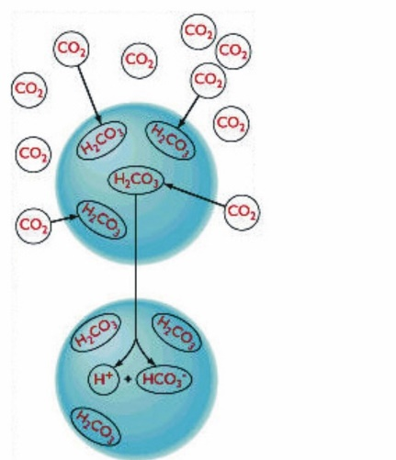
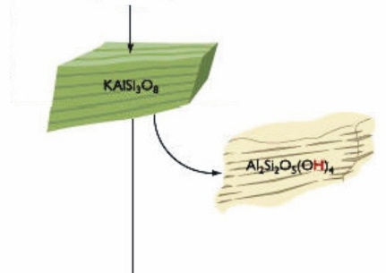
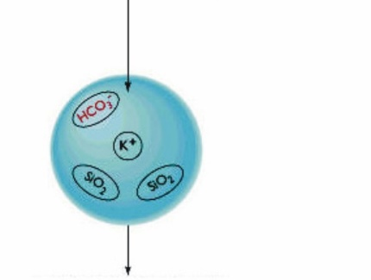
Goutte
de pluie
Une petite proportion
de CO₂ dans l’air
se dissout dans les gouttes
de pluie pour former de
l’acide carbonique
ALTÉRATION DES FELDSPATHS
DANS LA NATURE
(Hydratation)
Goutte
de pluie
Gouttes de pluie
légèrement acides
2KAlSi₃O₈ + 2H₂CO₃ + H₂O
Dissolution du potassium (K)
et de la silice (Si)
Feldspath + ac. carbon.+ eau
Al₂Si₂O₅(OH)₄ + 4SiO₂ + 2K⁺ + 2HCO₃⁻
kaolinite + (silice+ions K et bicarb.)
Transformation en kaolinite
(hydratation)
Silice, potassium et
bicarbonate en solution
partent dans les
rivières et les lacs

Slide 26
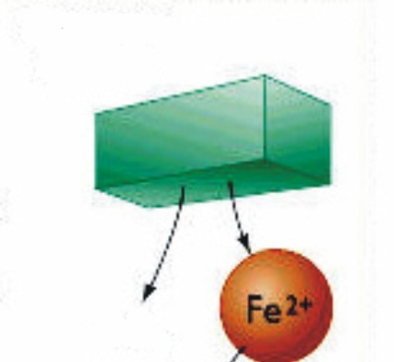
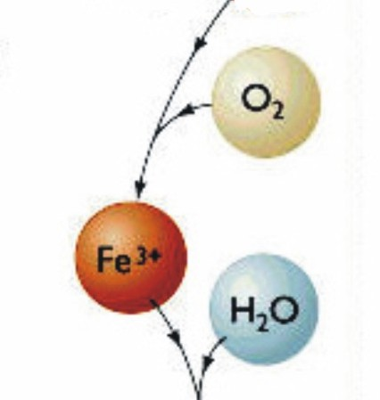
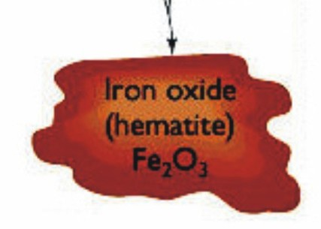
Pyroxène
FeSiO₃
ALTÉRATION D’UN PYROXÈNE
EN OXYDE DE FER
(Oxydation)
Le fer du pyroxène se
dissout et relâche de la
silice et du fer ferreux
en solution
SiO₂
Oxydation en fer
ferrique
4FeSiO₃ + O₂ 2Fe₂O₃ + 4SiO₂
Pyroxène + oxygène
hématite + silice
en solution
Précipitation du Fe ³⁺
l’eau pour former un
minéral (hématite)

Slide 27
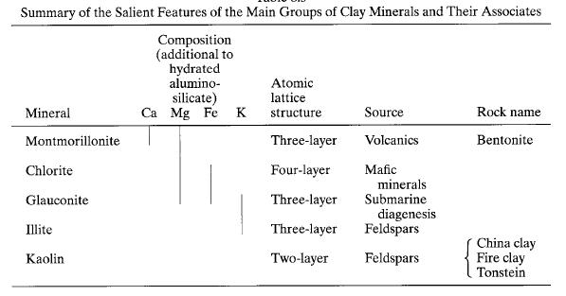

Slide 32
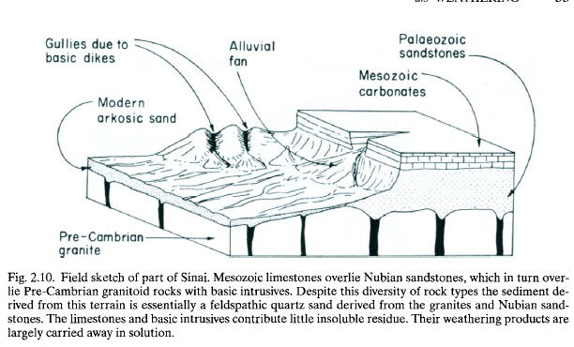

Slide 33
